Slide 1

BitByteBeat ♪
The Music Genre Classification Bot
Group 15: Siu Ye [40032209], Johnny On [40137434],
Chelsie Ng [40071692], Tyler Shanks [401307528]
Notes:
**mention that it is a custom project on music genre classification (use abstract or intro from report for script)
Hello everyone
This is group15’s presentation on our custom project on music genre classification called: BitByteBeat
We perform music genre classification manually using our own understanding of music.
In this project, we aim to develop a music genre classifier that will accurately predict a song’s genre by using a deep learning approach.
Specifically, we will train two different models using two types of neural network architectures, namely, Convolution Neural Networks(CNN) and Recurrent Neural Networks (RNN).

Slide 2
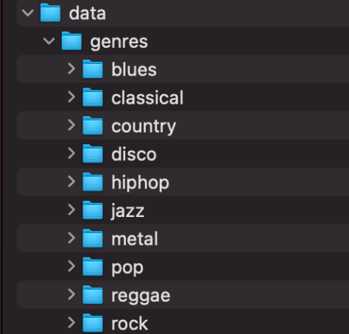
MGR Dataset
GTZAN Dataset - Music Genre Classification
Collection of 10 genres with 100 audio (.wav) files each folder
Jazz sample 54 corrupted
Notes:
Our dataset comes from the GTZAN Dataset - Music Genre Classification which is a popular public dataset for music genre recognition (MGR). This is a 1.41 GB folder containing training data that was used to train our models. The particular folder of interest was the Data/genresl as it contained a collection of 10 genres with 100 audio (.wav) files each. These files were all 30 seconds in length. The 10 genres within this set are the following: blues, classical, country, disco, hiphop, jazz, metal, pop, reggae and rock.
Note: The sample song titled 0054 was corrupted from the Jazz subfolder. This one was discarded from our project.
We would like to note that sample 54 within the jazz set was discarded when training the models as the file was corrupted.

Slide 3
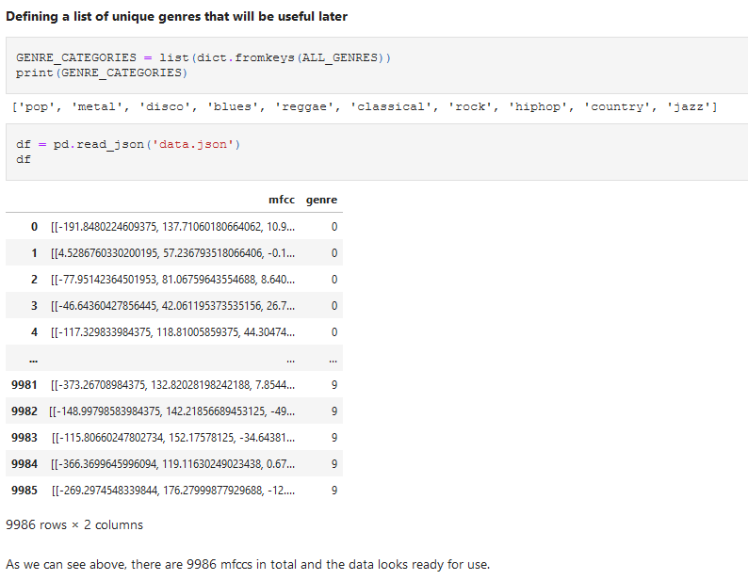
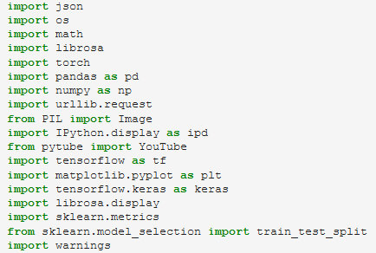
Architecture Overview
Importing modules
Loading Dataset
Analyze Distributions
Genre Distribution
Inspecting Genres
Split and Preprocess the data
Modeling and Training
CNN
RNN
Evaluating Models
Notes:
Why we chose CNN and RNN?
A neural network is based on the process of learning in human brains. Using new data, the computer is able to learn, and fine tune itself, by analyzing an artificial network of functions. The parameters, also called neurons, are functions that produce an output after receiving one or more inputs. The subsequent layer of neurons uses them as inputs in their own function and generates further outputs based on those inputs. This process continues until the neurons at the terminal level have received their input from every layer of neurons. The final result is then output from the terminal neurons.
Spectrograms are visual representations of audio data across time and frequency. A spectrogram is similar to an image since each has its own distinct pattern, which makes CNN an interesting neural network architecture for this project. The RNN excels at understanding sequential data by creating dependent hidden states at time t based on hidden states at time t-1. RNNs are able to do a much better job of identifying short-term and long-term temporal patterns in spectrograms because they have a time component.

Slide 4
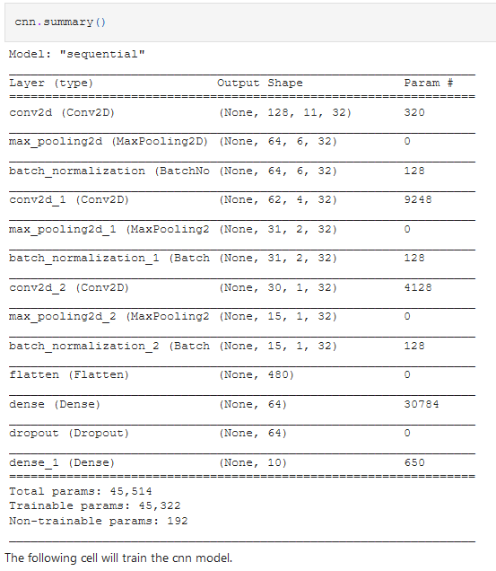
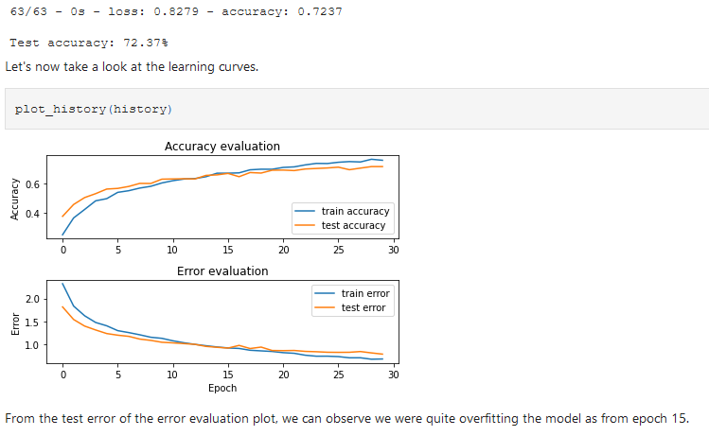
Convolution Neural Network
Notes:
When looking at the Convolution neural network, as expected, the model increases its accuracy over time while decreasing error.
CNN model attained a testing accuracy of 72.37%

Slide 5
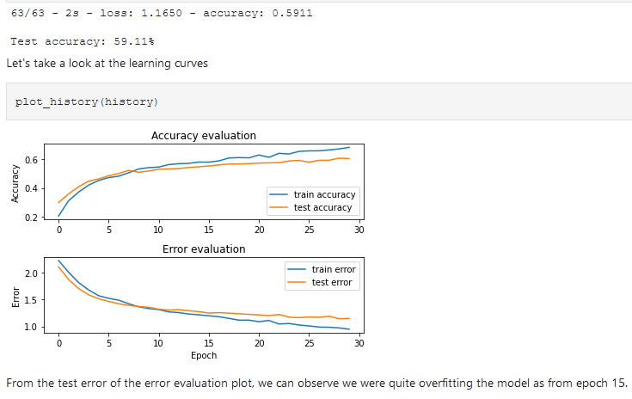
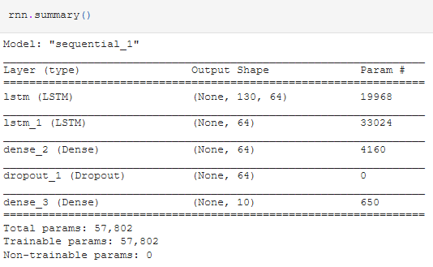
Recurrent Neural Network
Notes:
As previously seen, over time, the RNN model increases its accuracy over time while decreasing error.
However, the RNN model attained a testing accuracy of 59.11% which is notably lower than the CNN model.

Slide 6
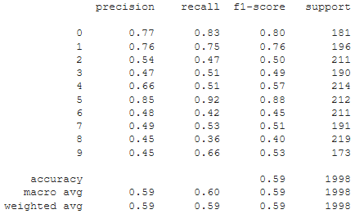
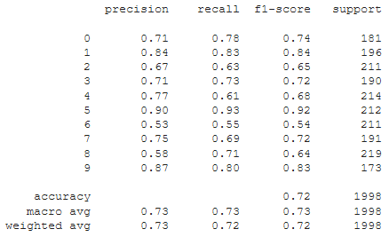
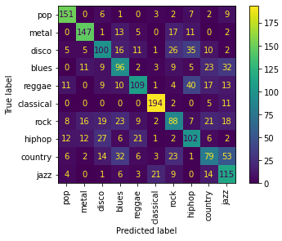
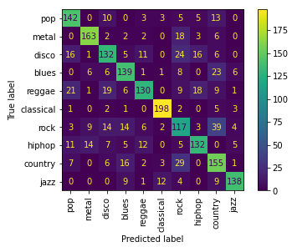
Comparing RNN vs CNN
Notes:
RNN on left, CNN on right
As we can see from the confusion matrix above, our cnn model misclassified rock as country the most, while it best prediction is classical music.
Whereas our rnn model misclassified country as jazz the most, while it best prediction is classical music.
When looking at the classification report, our CNN model has a higher precision, recall and f1 score than RNN
Overall the CNN model provided us with the best results, attaining a testing accuracy of 72.37%

Slide 7
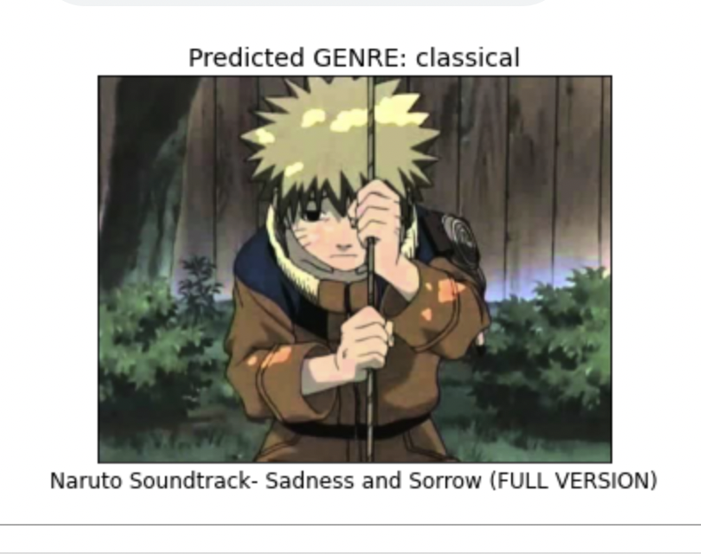
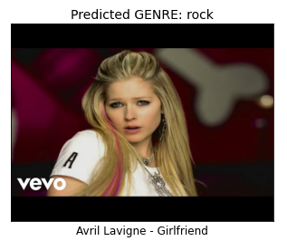
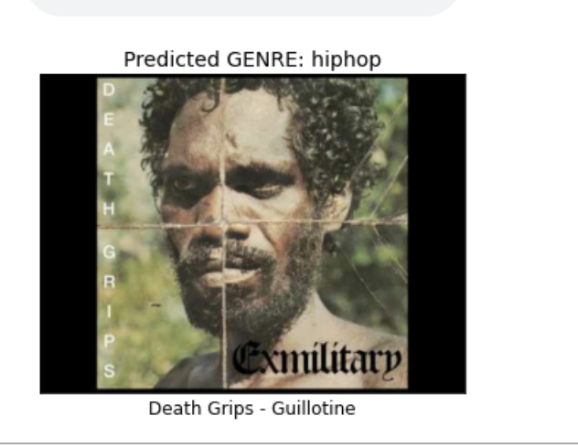
Future Plans
To improve BitByteBeat, we would implement the following:
Add additional training data for other types genres and possible sub genres
Improve accuracy by expanding our dataset
Explore with other models or audio features
Notes:
In the event that we plan to further improve BitByteBeat, we agreed that we would require substantially more training data, both in the form of more genre types as well as overall dataset size.
With this we could classify a larger set of songs more accurately.
In addition we also discussed the prospect of testing it with other models like KNN or audio features like Volume, Energy, pitch, etc with the MFCC.
We could also try applying feature selection techniques to identify optimal features to further improve results.
We also attempted to implement the same models using pytorch instead of tensorflow’s keras in hopes to compare the efficiency and accuracies of the models but was unsuccessful.

